Slide 1
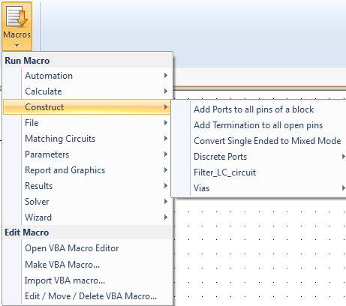
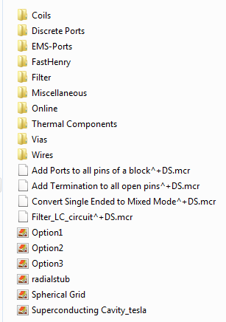
Macro
Installation path + \CST STUDIO SUITE \Library\Macros\Construct

Slide 2
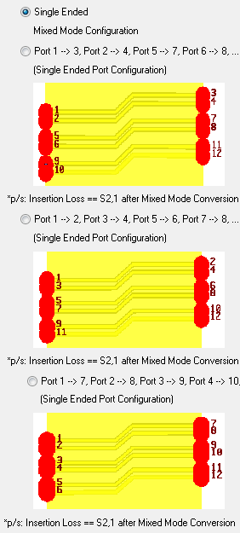
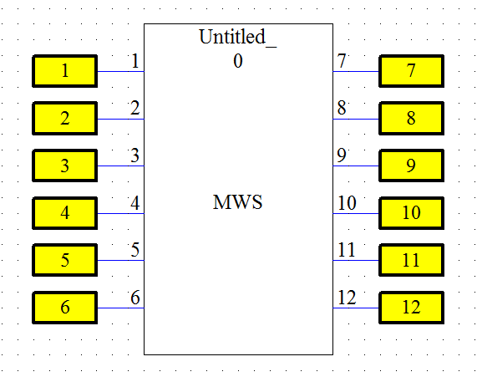
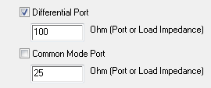
Single Ended Option
External Port will be created if the options are checked. Otherwise, termination load will be created
Common Mode Port will be numbered after Differential Port
Impedance will be defined on either external port or termination load (depends on choices)
S2,1 will be insertion loss (differential or common mode if differential port is not defined)

Slide 3
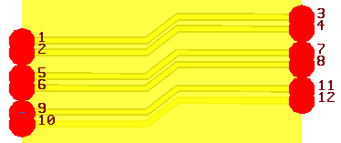
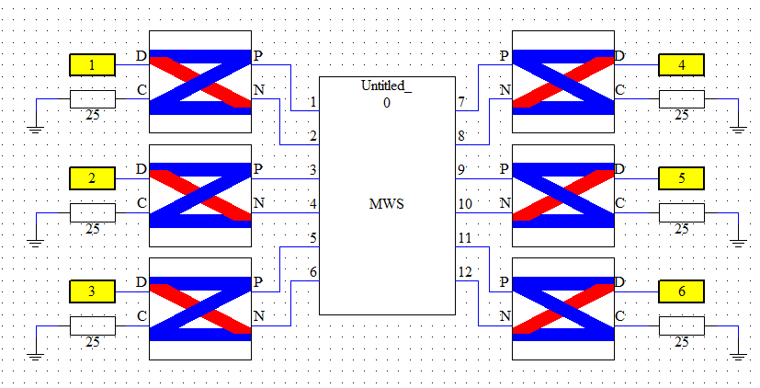
Option 1
Single Ended Configuration
Port 1 → Port 3
Port 2 → Port 4
.
.
.
.
Port 10 → Port 12
P ➔ Port 1 … P ➔ Port 3
N ➔ Port 2 … N ➔ Port 4
S2,1 ➔ Differential Insertion Loss

Slide 4
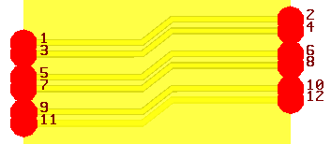
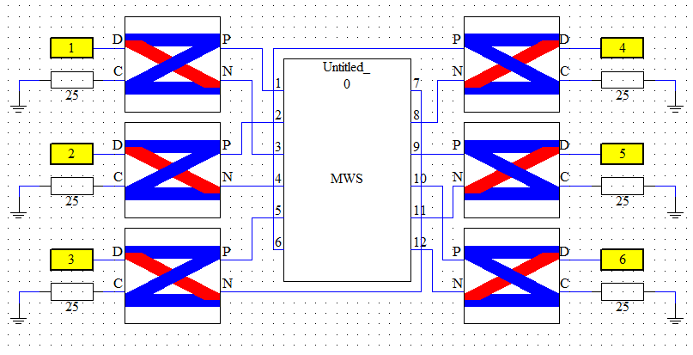
Option 2
Single Ended Configuration
Port 1 → Port 2
Port 3 → Port 4
.
.
.
.
Port 10 → Port 12
P ➔ Port 1 … P ➔ Port 2
N ➔ Port 3 … N ➔ Port 4
S2,1 ➔ Differential Insertion Loss

Slide 5
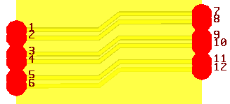
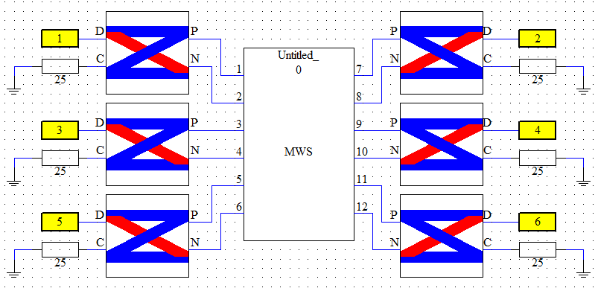
Option 3
Single Ended Configuration
Port 1 → Port 7
Port 2 → Port 8
.
.
.
.
Port 6 → Port 12
P ➔ Port 1 … P ➔ Port 7
N ➔ Port 2 … N ➔ Port 8
S2,1 ➔ Differential Insertion Loss

